Slide 1
Reliable Programming
Xueyuan Gong
Jinan University
xygong@jnu.edu.cn

Slide 2
Software quality
Creating a successful software product does not simply mean providing useful features for users.
You need to create a high-quality product that people want to use.
Customers have to be confident that your product will not crash or lose information, and users have to be able to learn to use the software quickly and without mistakes.

Slide 3
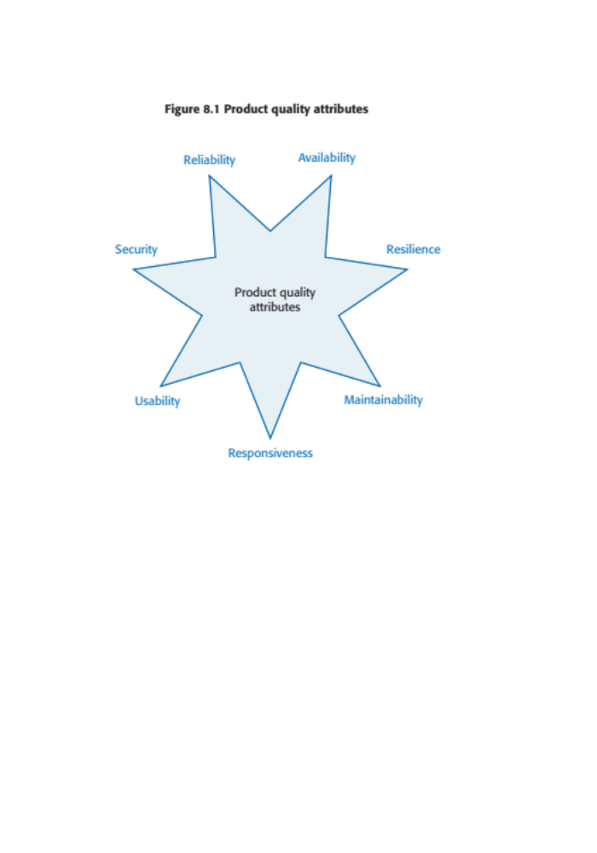
Figure 8.1 Software product quality attributes

Slide 4
Programming for reliability
There are three simple techniques for reliability improvement that can be applied in any software company.
  Fault avoidance You should program in such a way that you avoid introducing faults into your program.
  Input validation You should define the expected format for user inputs and validate that all inputs conform to that format.
  Failure management You should implement your software so that program failures have minimal impact on product users.

Slide 5
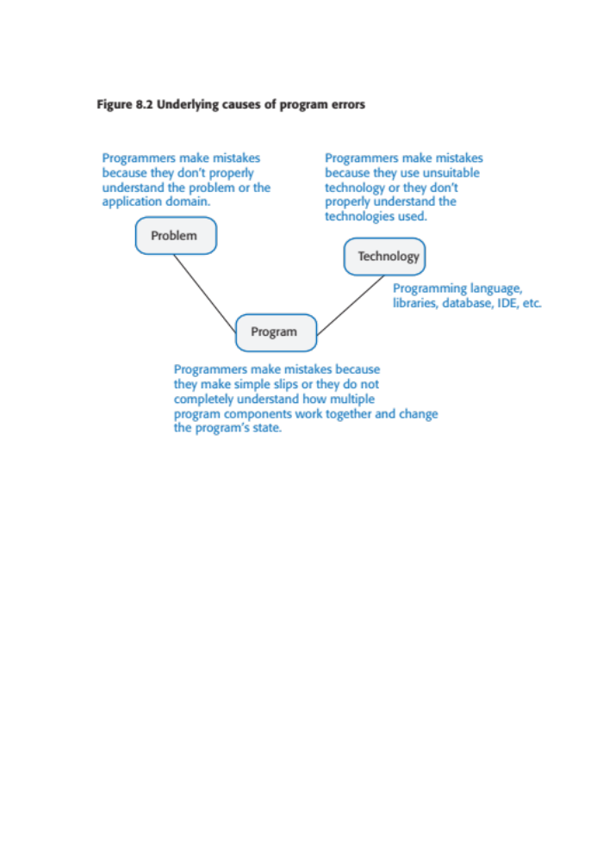
Figure 8.2 Underlying causes of program errors

Slide 6
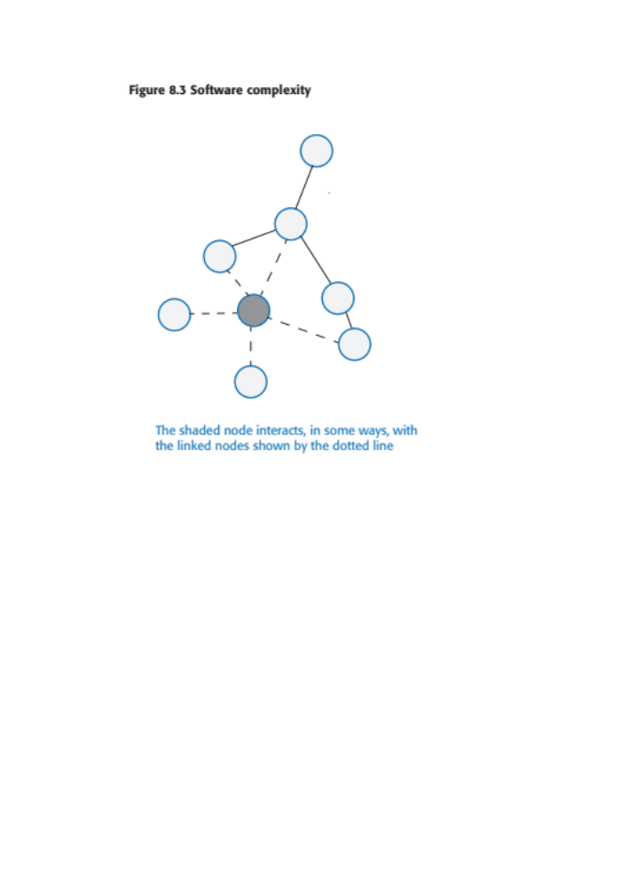
Figure 8.3 Software complexity

Slide 7
Program complexity
Complexity is related to the number of relationships between elements in a program and the type and nature of these relationships
The number of relationships between entities is called the coupling. The higher the coupling, the more complex the system.
  The shaded node in Figure 8.3 has a relatively high coupling because it has relationships with six other nodes.
A static relationship is one that is stable and does not depend on program execution.
  Whether or not one component is part of another component is a static relationship.
Dynamic relationships, which change over time, are more complex than static relationships.
  An example of a dynamic relationship is the ‘calls’ relationship between functions.

Slide 8
Types of complexity
Reading complexity
This reflects how hard it is to read and understand the program.
Structural complexity
This reflects the number and types of relationship between the structures (classes, objects, methods or functions) in your program.
Data complexity
This reflects the representations of data used and relationships between the data elements in your program.
Decision complexity
This reflects the complexity of the decisions in your program

Slide 9
Table 8.1 Complexity reduction guidelines
Structural complexity
  Functions should do one thing and one thing only
  Functions should never have side-effects
  Every class should have a single responsibility
  Minimize the depth of inheritance hierarchies
  Avoid multiple inheritance
  Avoid threads (parallelism) unless absolutely necessary
Data complexity
  Define interfaces for all abstractions
  Define abstract data types
  Avoid using floating-point numbers
  Never use data aliases
Conditional complexity
  Avoid deeply nested conditional statements
  Avoid complex conditional expressions

Slide 10
Ensure that every class has a single responsibility
You should design classes so that there is only a single reason to change a class.
  If you adopt this approach, your classes will be smaller and more cohesive.
  They will therefore be less complex and easier to understand and change.
The notion of ‘a single reason to change’ is, I think, quite hard to understand. However, in a blog post, Bob Martin explains the single responsibility principle in a much better way:
  Gather together the things that change for the same reasons.
  Separate those things that change for different reasons.*

Slide 11
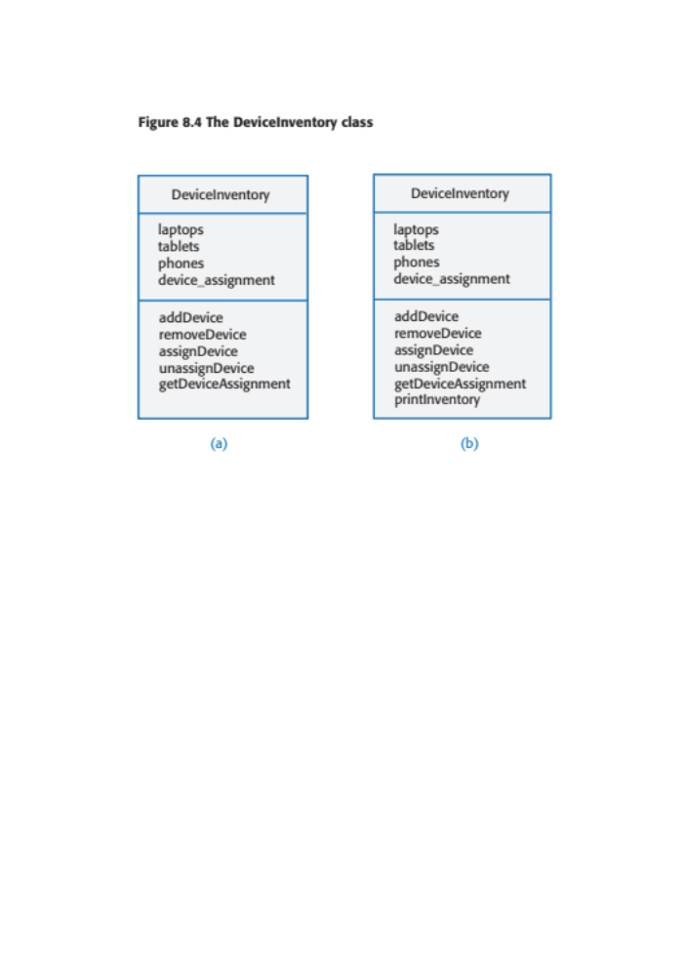
Figure 8.4 The DeviceInventory class

Slide 12
Adding a printInventory method
One way of making this change is to add a printInventory method, as shown in Figure 8.4 (b).
This change breaks the single responsibility principle as it then adds an additional ‘reason to change’ the class.
  Without the printInventory method, the reason to change the class is that there has been some fundamental change in the inventory, such as recording who is using their personal phone for business purposes.
  However, if you add a print method, you are associating another data type (a report) with the class. Another reason for changing this class might then be to change the format of the printed report.
Instead of adding a printInventory method to DeviceInventory, it is better to add a new class to represent the printed report as shown in Figure 8.5.

Slide 13
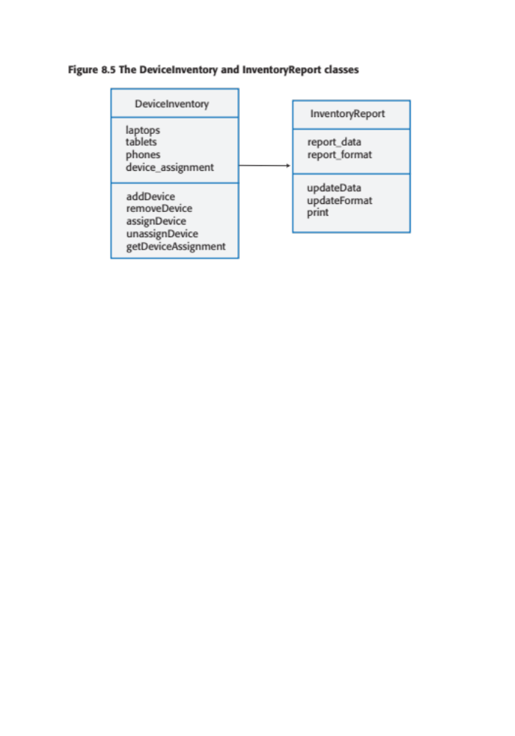
Figure 8.5 The DeviceInventory and InventoryReport classes

Slide 14
Avoid deeply nested conditional statements
Deeply nested conditional (if) statements are used when you need to identify which of a possible set of choices is to be made.
For example, the function ‘agecheck’ in Program 8.1 is a short Python function that is used to calculate an age multiplier for insurance premiums.
  The insurance company’s data suggests that the age and experience of drivers affects the chances of them having an accident, so premiums are adjusted to take this into account.
  It is good practice to name constants rather than using absolute numbers, so Program 8.1 names all constants that are used.

Slide 15
Program 8.1 Deeply nested if-then-else statements
YOUNG_DRIVER_AGE_LIMIT = 25
OLDER_DRIVER_AGE = 70
ELDERLY_DRIVER_AGE = 80
YOUNG_DRIVER_PREMIUM_MULTIPLIER = 2
OLDER_DRIVER_PREMIUM_MULTIPLIER = 1.5
ELDERLY_DRIVER_PREMIUM_MULTIPLIER = 2
YOUNG_DRIVER_EXPERIENCE_MULTIPLIER = 2
NO_MULTIPLIER = 1
YOUNG_DRIVER_EXPERIENCE = 2
OLDER_DRIVER_EXPERIENCE = 5
def agecheck (age, experience):
# Assigns a premium multiplier depending on the age and experience of the driver
multiplier = NO_MULTIPLIER
if age <= YOUNG_DRIVER_AGE_LIMIT:
if experience <= YOUNG_DRIVER_EXPERIENCE:
multiplier = YOUNG_DRIVER_PREMIUM_MULTIPLIER *
YOUNG_DRIVER_EXPERIENCE_MULTIPLIER
else:
multiplier = YOUNG_DRIVER_PREMIUM_MULTIPLIER
else:
if age > OLDER_DRIVER_AGE and age <= ELDERLY_DRIVER_AGE:
if experience <= OLDER_DRIVER_EXPERIENCE:
multiplier = OLDER_DRIVER_PREMIUM_MULTIPLIER
else:
multiplier = NO_MULTIPLIER
else:
if age > ELDERLY_DRIVER_AGE:
multiplier = ELDERLY_DRIVER_PREMIUM_MULTIPLIER
return multiplier

Slide 16
Program 8.2
Using guards to make a selection
def agecheck_with_guards (age, experience):
if age <= YOUNG_DRIVER_AGE_LIMIT and experience <= YOUNG_DRIVER_EXPERIENCE:
return YOUNG_DRIVER_PREMIUM_MULTIPLIER * YOUNG_DRIVER_EXPERIENCE_MULTIPLIER
if age <= YOUNG_DRIVER_AGE_LIMIT:
return YOUNG_DRIVER_PREMIUM_MULTIPLIER
if (age > OLDER_DRIVER_AGE and age <= ELDERLY_DRIVER_AGE) and experience <= OLDER_DRIVER_EXPERIENCE:
return OLDER_DRIVER_PREMIUM_MULTIPLIER
if age > ELDERLY_DRIVER_AGE:
return ELDERLY_DRIVER_PREMIUM_MULTIPLIER
return NO_MULTIPLIER

Slide 17
Avoid deep inheritance hierarchies
Inheritance allows the attributes and methods of a class, such as RoadVehicle, can be inherited by sub-classes, such as Truck, Car and MotorBike.
Inheritance appears to be an effective and efficient way of reusing code and of making changes that affect all subclasses.
However, inheritance increases the structural complexity of code as it increases the coupling of subclasses. For example, Figure 8.6 shows part of a 4-level inheritance hierarchy that could be defined for staff in a hospital.
The problem with deep inheritance is that if you want to make changes to a class, you have to look at all of its superclasses to see where it is best to make the change.
You also have to look at all of the related subclasses to check that the change does not have unwanted consequences. It’s easy to make mistakes when you are doing this analysis and introduce faults into your program.

Slide 18
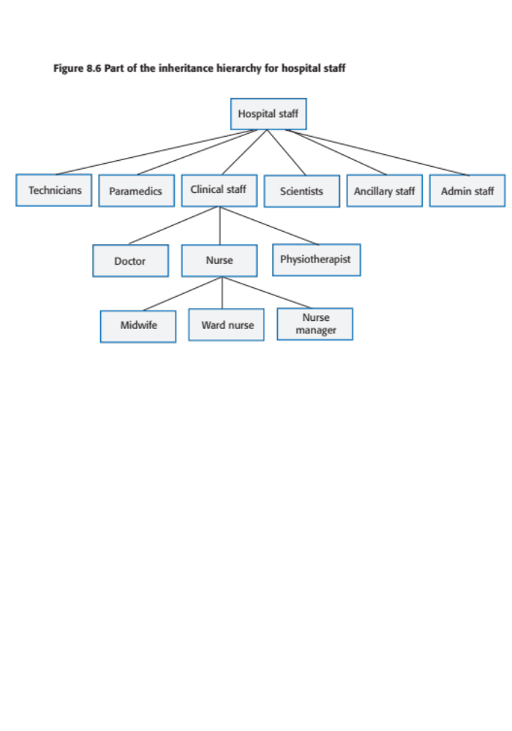
Figure 8.6 Part of the inheritance hierarchy for hospital staff

Slide 19
Design pattern definition
Definition
  A general reusable solution to a commonly-occurring problem within a given context in software design.
Design patterns are object-oriented and describe solutions in terms of objects and classes. They are not off-the-shelf solutions that can be directly expressed as code in an object-oriented language.
They describe the structure of a problem solution but have to be adapted to suit your application and the programming language that you are using.

Slide 20
Programming principles
Separation of concerns
  This means that each abstraction in the program (class, method, etc.) should address a separate concern and that all aspects of that concern should be covered there. For example, if authentication is a concern in your program, then everything to do with authentication should be in one place, rather than distributed throughout your code.
Separate the ‘what’ from the ‘how
  If a program component provides a particular service, you should make available only the information that is required to use that service (the ‘what’). The implementation of the service (‘the how’) should be of no interest to service users.

Slide 21
Common types of design patterns
Creational patterns
  These are concerned with class and object creation. They define ways of instantiating and initializing objects and classes that are more abstract than the basic class and object creation mechanisms defined in a programming language.
Structural patterns
  These are concerned with class and object composition. Structural design patterns are a description of how classes and objects may be combined to create larger structures.
Behavioural patterns
  These are concerned with class and object communication. They show how objects interact by exchanging messages, the activities in a process and how these are distributed amongst the participating objects.

Slide 22
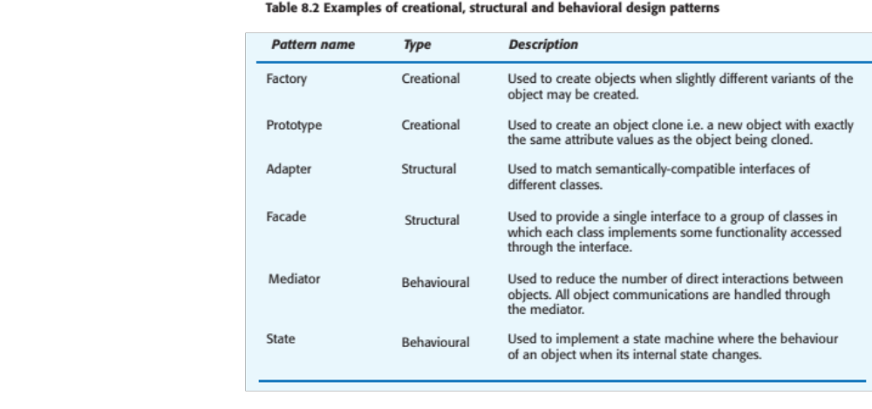
Table 8.2 Examples of design patterns

Slide 23
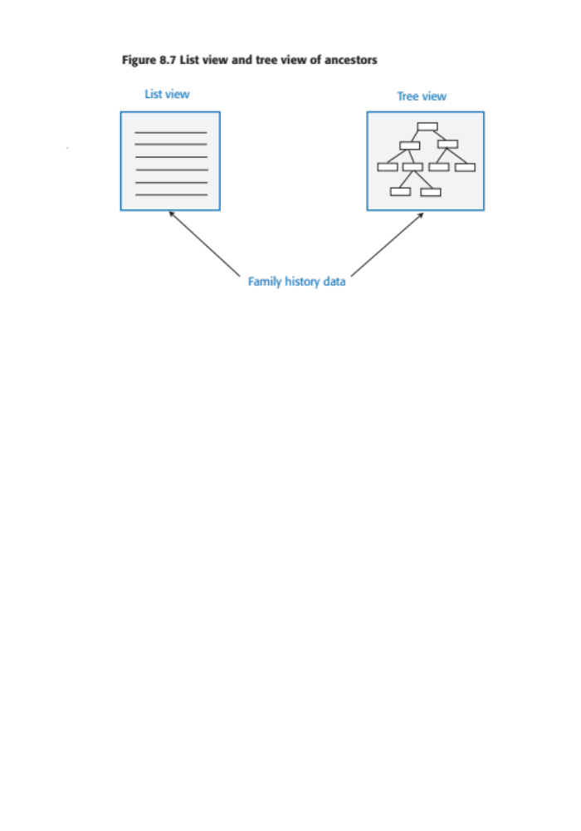
Figure 8.7 List view and tree view
Presenting multiple views of the same data

Slide 24
Table 8.3 The Observer pattern (1)
Description
This pattern separates the display of an object from the object itself. There may be multiple displays associated with the object. When one display is changed, all others are notified and take action to update themselves.
Problem
Many applications present multiple views (displays) of the same data with the requirement that all views must be updated when any one view is changed. You may also wish to add new views without the object, whose state is being displayed, knowing about the new view or how the information is presented.
Solution
The state to be displayed (sometimes called the Model) is maintained in a Subject class that includes methods to add and remove observers and to get and set the state of the Model. An observer is created for each display and registers with the Subject. When an observer uses the set method to change the state, the Subject notifies all other Observers. They then use the Subject’s getState( ) method to update their local copy of the state and so change their display. Adding a new display simply involves notifying the Subject that a new display has been created.

Slide 25
Figure 8.3 The Observer pattern (2)
Implementation
This pattern is implemented using abstract and concrete classes. The abstract Subject class includes methods to register and deregister observers and to notify all observers that a change has been made. The abstract Observer class includes a method to update the local state of each observer. Each Observer subclass implements these methods and is responsible for managing its own display. When notifications of a change are received, the Observer subclasses access the model using the getState( ) method to retrieve the changed information.
Things to consider
The Subject does not know how the Model is displayed so cannot organize its data to optimize the display performance. If a display update fails, the Subject does not know that the update has been unsuccessful.

Slide 26
Pattern description
Design patterns are usually documented in the stylized way. This includes:
  a meaningful name for the pattern and a brief description of what it does;
  a description of the problem it solves;
  a description of the solution and its implementation;
  the consequences and trade-offs of using the pattern and other issues that you should consider.

Slide 27
Refactoring
Refactoring means changing a program to reduce its complexity without changing the external behaviour of that program.
Refactoring makes a program more readable (so reducing the ‘reading complexity’) and more understandable.
It also makes it easier to change, which means that you reduce the chances of making mistakes when you introduce new features.
The reality of programming is that as you make changes and additions to existing code, you inevitably increase its complexity.
  The code becomes harder to understand and change. The abstractions and operations that you started with become more and more complex because you modify them in ways that you did not originally anticipate.

Slide 28
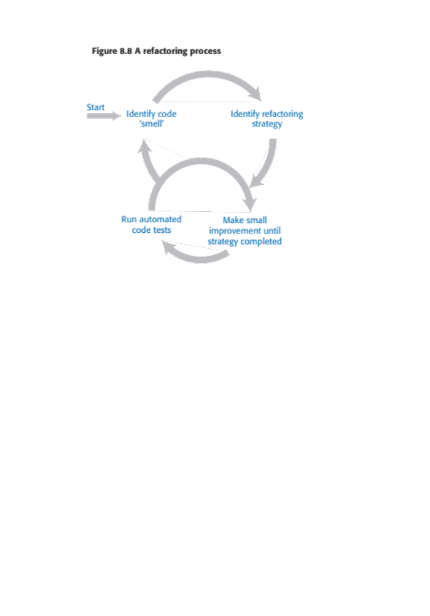
Figure 8.8 A refactoring process

Slide 29
Code smells
Martin Fowler, a refactoring pioneer, suggests that the starting point for refactoring should be to identify code ‘smells’.
Code smells are indicators in the code that there might be a deeper problem.
  For example, very large classes may indicate that the class is trying to do too much. This probably means that its structural complexity is high.

Slide 30
Table 8.6 Examples of code smells
Large classes
Large classes may mean that the single responsibility principle is being violated. Break down large classes into easier-to-understand, smaller classes.
Long methods/functions
Long methods or functions may indicate that the function is doing more than one thing. Split into smaller, more specific functions or methods.
Duplicated code
Duplicated code may mean that when changes are needed, these have to be made everywhere the code is duplicated. Rewrite to create a single instance of the duplicated code that is used as required
Meaningless names
Meaningless names are a sign of programmer haste. They make the code harder to understand. Replace with meaningful names and check for other shortcuts that the programmer may have taken.
Unused code
This simply increases the reading complexity of the code. Delete it even if it has been commented out. If you find you need it later, you should be able to retrieve it from the code management system.

Slide 31
Table 8.7 Examples of refactoring for complexity reduction
Reading complexity
You can rename variable, function and class names throughout your program to make their purpose more obvious.
Structural complexity
You can break long classes or functions into shorter units that are likely to be more cohesive than the original large class.
Data complexity
You can simplify data by changing your database schema or reducing its complexity. For example, you can merge related tables in your database to remove duplicated data held in these tables.
Decision complexity
You can replace a series of deeply nested if-then-else statements with guard clauses, as I explained earlier in this chapter.

Slide 32
Input validation
Input validation involves checking that a user’s input is in the correct format and that its value is within the range defined by input rules.
Input validation is critical for security and reliability. As well as inputs from attackers that are deliberately invalid, input validation catches accidentally invalid inputs that could crash your program or pollute your database.
User input errors are the most common cause of database pollution.
You should define rules for every type of input field and you should include code that applies these rules to check the field’s validity.
  If it does not conform to the rules, the input should be rejected.

Slide 33
Rules for name checking
The length of a name should be between 2 and 40 characters.
The characters in the name must be alphabetic or alphabetic characters with an accent, plus a small number of special separator characters. Names must start with a letter.
The only non-alphabetic separator characters allowed are hyphen, and apostrophe.
If you use rules like these, it becomes impossible to input very long strings that might lead to buffer overflow, or to embed SQL commands in a name field.

Slide 34
Table 8.8 Methods of implementing input validation
Built-in validation functions
You can use input validator functions provided by your web development framework. For example, most frameworks include a validator function that will check that an email address is of the correct format.
Type coercion functions
You can use type coercion functions, such as int() in Python, that convert the input string into the desired type. If the input is not a sequence of digits, the conversion will fail.
Explicit comparisons
You can define a list of allowed values and possible abbreviations and check inputs against this list. For example, if a month is expected, you can check this against a list of all months and recognised abbreviations.
Regular expressions
You can use regular expressions to define a pattern that the input should match and reject inputs that do not match that pattern.

Slide 35
Regular expressions
Regular expressions (REs) are a way of defining patterns.
A search can be defined as a pattern and all items matching that pattern are returned. For example, the following Unix command will list all the JPEG files in a directory:
ls | grep ..*\.jpg$
A single dot means ‘match any character’ and \* means zero or more repetitions of the previous character. Therefore ..\* means ‘one or more characters’. The file prefix is .jpg and the $ character means that it must occur at the end of a line.
In Program 8.3, REs are used to check the validity of names.

Slide 36
Program 8.3 A name checking function
def namecheck (s):
# checks that a name only includes alphabetic characters, -, or single quote
# names must be between 2 and 40 characters long
# quoted strings and -- are disallowed
namex = r"^[a-zA-Z][a-zA-Z-']{1,39}$"
if re.match (namex, s):
if re.search ("'.*'", s) or re.search ("--", s):
return False
else:
return True
else:
return False

Slide 37
Number checking
Number checking is used with numeric inputs to check that these are not too large or small and that they are sensible values for the type of input.
  For example, if the user is expected to input their height in meters then you should expect a value between 0.6m (a very small adult) and 2.6m (a very tall adult).
Number checking is important for two reasons:
  If numbers are too large or too small to be represented, this may lead to unpredictable results and numeric overflow or underflow exceptions. If these exceptions are not properly handled, very large or very small inputs can cause a program to crash.
  The information in a database may be used by several other programs and these may make assumptions about the numeric values stored. If the numbers are not as expected, this may lead to unpredictable results.

Slide 38
Input range checks
As well as checking the ranges of inputs, you may also perform checks on these inputs to ensure that these represent sensible values.
These protect your system from accidental input errors and may also stop intruders who have gained access using a legitimate user’s credentials from seriously damaging their account.
For example, if a user is expected to enter the reading from an electricity meter, then you should
  (a) check this is equal to or larger than the previous meter reading and
  (b) consistent with the user’s normal consumption.

Slide 39
Failure management
Software is so complex that, irrespective of how much effort you put into fault avoidance, you will make mistakes. You will introduce faults into your program that will sometimes cause it to fail.
Program failures may also be a consequence of the failure of an external service or component that your software depends on.
Whatever the cause, you have to plan for failure and make provisions in your software for that failure to be as graceful as possible.

Slide 40
Failure categories
Data failures
  The outputs of a computation are incorrect. For example, if someone’s year of birth is 1981 and you calculate their age by subtracting 1981 from the current year, you may get an incorrect result. Finding this kind of error relies on users reporting data anomalies that they have noticed.
Program exceptions
  The program enters a state where normal continuation is impossible. If these exceptions are not handled, then control is transferred to the run-time system which halts execution. For example, if a request is made to open a file that does not exist then an IOexception has occurred.
Timing failures
  Interacting components fail to respond on time or where the responses of concurrently-executing components are not properly synchronized. For example, if service S1 depends on service S2 and S2 does not respond to a request, then S1 will fail.

Slide 41
Failure effect minimisation
Persistent data (i.e. data in a database or files) should not be lost or corrupted;
The user should be able to recover the work that they’ve done before the failure occurred;
Your software should not hang or crash;
You should always ‘fail secure’ so that confidential data is not left in a state where an attacker can gain access to it.

Slide 42
Exception handling
Exceptions are events that disrupt the normal flow of processing in a program.
When an exception occurs, control is automatically transferred to exception management code.
Most modern programming languages include a mechanism for exception handling.
In Python, you use **try-except** keywords to indicate exception handling code; in Java, the equivalent keywords are **try-catch.**

Slide 43
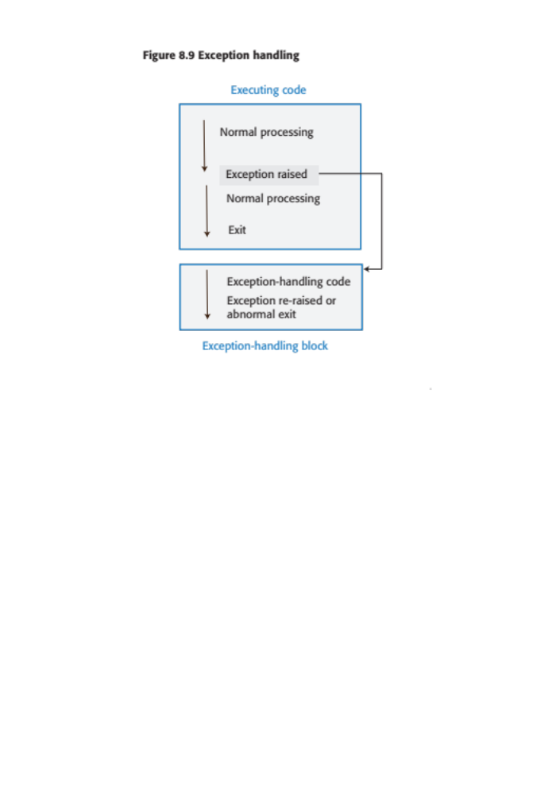
Figure 8.9 Exception handling

Slide 44
Program 8.4 Secure failure
def do_normal_processing (wf, ef):
# Normal processing here. Code below simulates exceptions rather than normal processing
try:
wf.write ('line 1\n')
ef.write ('encrypted line 1')
wf.write ('line 2\n')
wf.close()
print ('Force exception by trying to open non-existent file')
tst = open (test_root+'nofile')
except IOError as e:
print ('I/O exception has occurred')
raise e
def main ():
wf = open (test_root+'workfile.txt', 'w')
ef = open(test_root+'encrypted.txt', 'w')
try:
do_normal_processing (wf, ef)
except Exception:
# If the modification time of the unencrypted work file (wf) is
# later than the modification time of the encrypted file (ef)
# then encrypt and write the workfile
print ('Secure shutdown')
wf_modtime = os.path.getmtime(test_root+'workfile.txt')
ef_modtime = os.path.getmtime(test_root+'encrypted.txt')
if wf_modtime > ef_modtime:
encrypt_workfile (wf, ef)
else:
print ('Workfile modified before encrypted')
wf.close()
ef.close()
os.remove (test_root+'workfile.txt')
print ('Secure shutdown complete')

Slide 45
Auto-save and activity logging
Activity logging
  You keep a log of what the user has done and provide a way to replay that against their data. You don’t need to keep a complete session record, simply a list of actions since the last time the data was saved to persistent store.
Auto-save
  You automatically save the user’s data at set intervals - say every 5 minutes. This means that, in the event of a failure, you can restore the saved data with the loss of only a small amount of work.
  Usually, you don’t have to save all of the data but simply save the changes that have been made since the last explicit save.

Slide 46
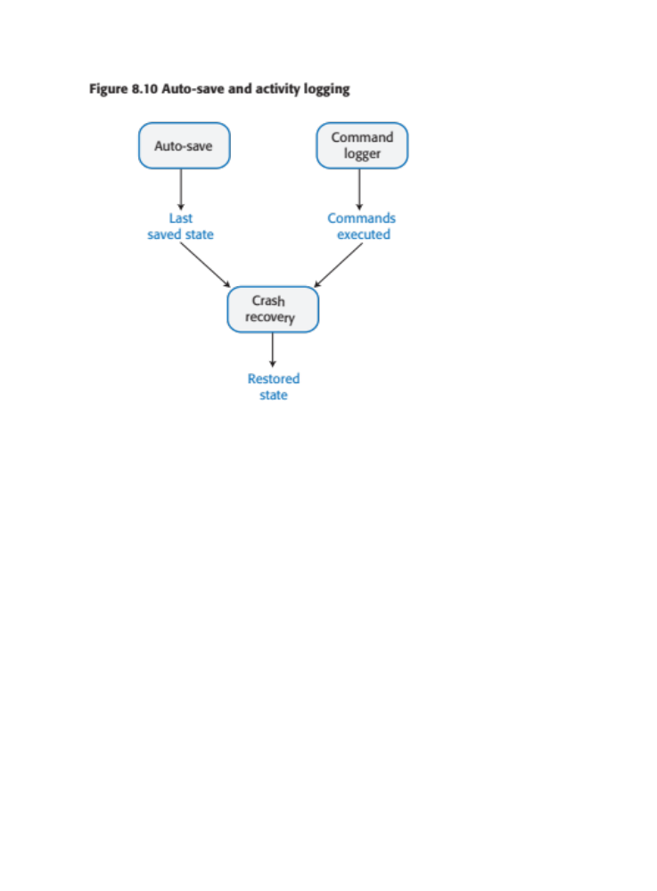
Figure 8.10 Auto-save and activity logging

Slide 47
External service failure
If your software uses external services, you have no control over these services and the only information that you have on service failure is whatever is provided in the service’s API.
As services may be written in different programming languages, these errors can’t be returned as exception types but are usually returned as a numeric code.
When you are calling an external service, you should always check that the return code of the called service indicates that it has operated successfully.
You should, also, if possible, check the validity of the result of the service call as you cannot be certain that the external service has carried out its computation correctly.

Slide 48
Program 8.5 Using assertions to check results from an external service
def credit_checker (name, postcode, dob):
# Assume that the function check_credit_rating calls an external service
# to get a person's credit rating. It takes a name, postcode (zip code)
# and date of birth as parameters and returns a sequence with the database
# information (name, postcode, date of birth) plus a credit score between 0 and
# 600. The final element in the sequence is an error_code which may
# be 0 (successful completion), 1 or 2.
NAME = 0
POSTCODE = 1
DOB = 2
RATING = 3
RETURNCODE = 4
REQUEST_FAILURE = True
ASSERTION_ERROR = False
cr = ['', '', '', -1, 2]
# Check credit rating simulates call to external service
cr = check_credit_rating (name, postcode, dob)
try:
assert cr [NAME] == name and cr [POSTCODE] == postcode and cr [DOB] == dob \
and (cr [RATING] >= 0 and cr [RATING] <= 600) and \
(cr[RETURNCODE] >= 0 and cr[RETURNCODE] <= 2)
if cr[RETURNCODE] == 0:
do_normal_processing (cr)
else:
do_exception_processing (cr, name, postcode, dob, REQUEST_FAILURE)
except AssertionError:
do_exception_processing (cr, name, postcode, dob, ASSERTION_ERROR)

Slide 49
Key points 1
The most important quality attributes for most software products are reliability, security, availability, usability, responsiveness and maintainability.
To avoid introducing faults into your program, you should use programming practices that reduce the probability that you will make mistakes.
You should always aim to minimize complexity in your programs. Complexity makes programs harder to understand. It increases the chances of programmer errors and makes the program more difficult to change.
Design patterns are tried and tested solutions to commonly occurring problems. Using patterns is an effective way of reducing program complexity.
Refactoring is the process of reducing the complexity of an existing program without changing its functionality. It is good practice to refactor your program regularly to make it easier to read and understand.
Input validation involves checking all user inputs to ensure that they are in the format that is expected by your program. Input validation helps avoid the introduction of malicious code into your system and traps user errors that can pollute your database.

Slide 50
Key points 2
Regular expressions are a way of defining patterns that can match a range of possible input strings. Regular expression matching is a compact and fast way of checking that an input string conforms to the rules you have defined.
You should check that numbers have sensible values depending on the type of input expected. You should also check number sequences for feasibility.
You should assume that your program may fail and to manage these failures so that they have minimal impact on the user.
Exception management is supported in most modern programming languages. Control is transferred to your own exception handler to deal with the failure when a program exception is detected.
You should log user updates and maintain user data snapshots as your program executes. In the event of a failure, you can use these to recover the work that the user has done. You should also include ways of recognizing and recovering from external service failures.

